Slide 1


Unit 6
Supervisor validations
Notes:
Welcome to Unit 6 of Module 4.

Slide 2
By the end of this unit, you will be able to:
explain the supervisor’s role to assure data quality
identify the steps in the validation process
list the CSPro data collection tasks for the supervisor to validate data
Notes:
By the end of this unit, you will be able to:
explain the supervisor’s role to assure data quality
identify the steps in the validation process, and
list the CSPro data collection tasks for the supervisor to validate data.

Slide 3



Data quality assurance
Data quality assurance is an ongoing process.
All survey team members have a role to play.
area supervisor
team leader
data collector
Notes:
Data quality assurance is an ongoing process throughout the entire survey process.
All survey team members have a role to play in ensuring data quality.

Slide 4
Data quality assurance
Data quality assurance procedures include:
electronic data collection with automated skip patterns, range checks, consistency checks, and auto-fills
field supervision by survey coordinators and supervisors
validation by quality assurance team
frequent mobile phone communication for problem-solving
team leaders/supervisors’ monitoring of data completeness/correctness
Notes:
Data quality assurance procedures include:
electronic data collection with automated skip patterns, range checks, consistency checks, and auto-fills;
frequent mobile phone communication for rapid problem-solving and information-sharing;
field supervision by survey coordinators and supervisors;
validation through a sample of facilities to be re-surveyed by a quality assurance team (generally supervisors or an external quality assurance team); and
team leaders and supervisors’ monitoring of data completeness and correctness.

Slide 5
Area supervisor’s role
2 main roles in assuring HHFA survey data quality:
validation of data collector’s data
Area supervisor
tracking progress towards survey completion
Notes:
As we learned in Unit 2 regarding user roles, the supervisor has 2 main roles in assuring HHFA survey data quality:
validation of data collector’s data; and
tracking progress towards survey completion.

Slide 6

What is the supervisor’s validation?
The supervisor will do a validation visit in 10% of health facilities.
return to a selection of the sampled facilities – randomly selected
collect data again to make sure that the data obtained by the data collectors is accurate and reliable
Notes:
The supervisor will do a validation visit in 10% of health facilities.
This means that they will return to a selection of the sampled facilities.
The facilities for validation are randomly selected.
Supervisors collect data again to make sure that the data obtained by the data collectors is accurate and reliable.

Slide 7

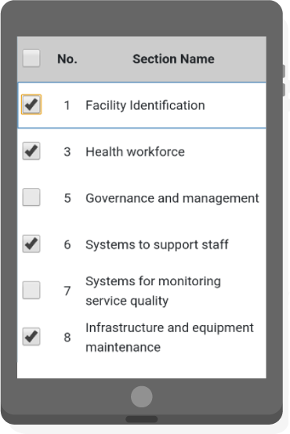
What is the supervisor’s validation?
A supervisor validation may be conducted using:
The entire HHFA questionnaire
Selected sections of the questionnaire
Notes:
A supervisor validation may be conducted using:
either the entire HHFA questionnaire; or
selected sections of the questionnaire.

Slide 8
What is the supervisor’s validation?
If validation is conducted on selected sections of the questionnaire:
different sections should be selected across different facilities
the survey coordination committee will decide which method to use
Notes:
If validation is conducted on selected sections of the questionnaire, different sections should be selected across different facilities, so that all sections are covered across the validation process for a specific team.
The survey coordination committee will decide which of the methods will be used.

Slide 9
Data validation steps
1
random selection of facilities for validation
4
identification and resolution of any issues
2
validation visit soon after data collector’s visits
5
analysis of the consistency of responses
3
comparison of validation data against collected data
use the HHFA CSPro application
data managers will support comparison/report discrepancies
Notes:
Data validation involves a number of steps:
random selection of facilities for validation;
validation visit as soon as possible after the data collectors’ visit (ideally on the same day);
comparison of the validation data obtained with that collected by the data collectors;
note that it is important to use the HHFA CSPro application to collect all supervisor validation data, as this will facilitate comparison of data between supervisor validations and data collectors;
the HHFA data managers will support the comparison between supervisor validation data and data collector data, and provide a report of discrepancies.
identification and resolution of any issues or mistakes through discussion with data collectors; and
analysis of the consistency of responses (exact matching between validation data and data collector data) as a measure of quality control.

Slide 10

Data validation steps
Not all questions are expected to be an exact match and not all differences are indicative of data quality problems.
For example:
minor differences in text-only fields
differences in issues likely to change quickly, such as the availability of medicines
Comparison results must be interpreted with a view toward identifying differences indicative of data quality problems.
Notes:
Remember, not all questions are expected to be an exact match and not all differences are indicative of data quality problems. For example:
minor differences in the spelling of facility location, or other text-only fields; and
differences in issues likely to change quickly, such as the availability of medicines, which may be true differences if the data was not collected on the same day.
The comparison results must therefore be interpreted with a view toward identifying differences that may be indicative of a problem with data quality.

Slide 11
Supervisor’s tasks in the CSPro HHFA application
No. | Who? | What? | When?
1 | Supervisor | Select sections for validation | Before arrival at facility
2 | Supervisor | Validate facility data | At facility
3 | Supervisor | Sync validation data | End of the day
4 | Supervisor | Download all data | As needed
5 | Supervisor | View reports | As needed
6 | Supervisor | Update application | As needed
When conducting a supervisor validation visit, only one person can collect data.
Notes:
There are a number of tasks that the supervisor must carry out in the CSPro HHFA application. ​
In this unit, we will look at the tasks that the supervisor needs to validate the data collected in the randomly selected health facilities:​
select sections for validation;​
validate facility data; and​
sync validation data.​
​
Note that, when conducting a supervisor validation visit, only one person can collect data; in other words, the sections cannot be divided amongst multiple supervisors to collect data at a single facility.​

Slide 12
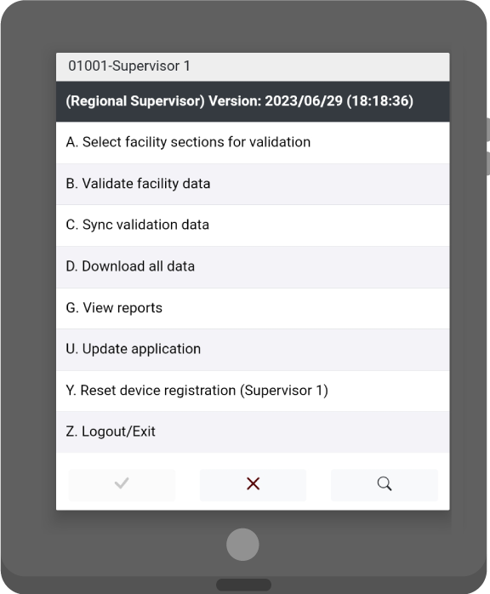
1. Select sections for data collection
The selection of sections for validation is done by the supervisor.
login to CSPro and click on “Select the facility sections for validation”
select the region, district and facility
select the sections to validate
confirm the assignments
Notes:
The selection of sections for validation is done by the supervisor.
This is similar to the assignment of sections to data collectors that team leaders do before arrival at the facility, and that we saw in unit 3.
It requires the supervisor to:
log in to CSPro and click on the “select the facility sections for validation” option from the main menu;
select the region, then the district, and then the facility to make assignments for;
select the sections to validate; and
confirm the assignments.

Slide 13
2. Validate facility data
The supervisor collects data for validation.
select “Validate facility data”
select the facility and confirm selection
record the status of the facility and collect GPS coordinates
start data collection navigation through the flow control form
Notes:
The data collection that the supervisor does for validation is similar to the data collection that data collectors do, and that we saw in unit 4.
It requires the supervisor to:
select “Validate facility data” option from the main menu;
select the facility among those listed and confirm the selection;
record the status of the facility;
collect GPS coordinates; and
start data collection navigation through the flow control form.

Slide 14



3. Sync validation data
Once validation data has been saved, the supervisor syncs it to the server.
Central Server
Notes:
Once the validation data has been entered and saved, the supervisor needs to sync it to the server.
This is similar to the way the data collector and the team leader synced data, but in this case, in addition to syncing data with the server, the syncing process also creates a combined data record for the facility.
The HHFA data managers will:
support the comparison between supervisor validation data and data collector data; and
provide a report of discrepancies.

Slide 15
You have now completed Unit 6.
In the next unit, we will look at how to track progress toward survey completion.
Notes:
You have now completed Unit 6.
In the next unit, we will look at how to track progress toward survey completion.

